Slide 1
Java If ... Else

Slide 2
Java Conditions and If Statements
Java supports the usual logical conditions from mathematics:
Less than: a < b
Less than or equal to: a <= b
Greater than: a > b
Greater than or equal to: a >= b
Equal to a == b
Not Equal to: a != b
You can use these conditions to perform different actions for different decisions.
Java has the following conditional statements:
Use if to specify a block of code to be executed, if a specified condition is true
Use else to specify a block of code to be executed, if the same condition is false
Use else if to specify a new condition to test, if the first condition is false
Use switch to specify many alternative blocks of code to be executed

Slide 3
The if Statement
Use the if statement to specify a block of Java code to be executed if a condition is true.
Syntax
if (condition) {
// block of code to be executed if the condition is true
}
Note that if is in lowercase letters. Uppercase letters (If or IF) will generate an error.

Slide 4
The else Statement
Use the else statement to specify a block of code to be executed if the condition is false.
Syntax
if (condition) {
// block of code to be executed if the condition is true
} else {
// block of code to be executed if the condition is false
}

Slide 5
The else if Statement
Use the else if statement to specify a new condition if the first condition is false.
Syntax
if (condition1) {
// block of code to be executed if condition1 is true
} else if (condition2) {
// block of code to be executed if the condition1 is false and condition2 is true
} else {
// block of code to be executed if the condition1 is false and condition2 is false
}

Slide 6
Short Hand If...Else (Ternary Operator)
There is also a short-hand if else, which is known as the ternary operator because it consists of three operands. It can be used to replace multiple lines of code with a single line. It is often used to replace simple if else statements:
Syntax
variable = (condition) ? expressionTrue : expressionFalse;

Slide 7
Example
int time = 20;
if (time < 18) {
System.out.println("Good day.");
} else {
System.out.println("Good evening.");
}
You can simply write:
Example
int time = 20;
String result = (time < 18) ? "Good day." : "Good evening.";
System.out.println(result);

Slide 8
Practice
with if, else
and if else
statement

Slide 9
1. Write a Java program to get a number from the user and print whether it is positive or negative.
Test Data
Input number: 35
Expected Output :
Number is positive

Slide 10
2. Write a Java program to solve quadratic equations (use if, else if and else).
Test Data Input a: 1 Input b: 5 Input c: 1 Expected Output : The roots are -0.20871215252208009 and -4.7912878474779195

Slide 11
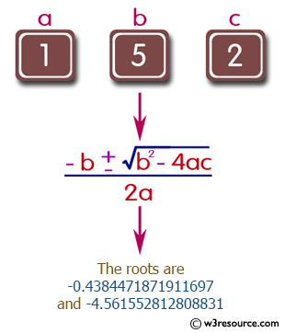

Slide 12
3. Take three numbers from the user and print the greatest number.
Test Data Input the 1st number: 25 Input the 2nd number: 78 Input the 3rd number: 87 Expected Output : The greatest: 87

Slide 13
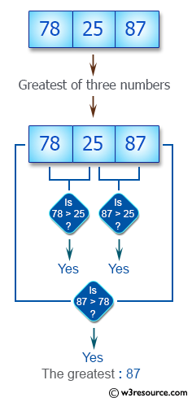

Slide 14
Java Switch Statements
Use the switch statement to select one of many code blocks to be executed.
Syntax
switch(expression) {
case x:
// code block
break;
case y:
// code block
break;
default:
// code block
}

Slide 15
This is how it works:
The switch expression is evaluated once.
The value of the expression is compared with the values of each case.
If there is a match, the associated block of code is executed.
The break and default keywords are optional, and will be described later in this chapter

Slide 16
The example below uses the weekday number to calculate the weekday name:
Example
int day = 4;
switch (day) {
case 1:
System.out.println("Monday");
break;
case 2:
System.out.println("Tuesday");
break;
case 3:
System.out.println("Wednesday");
break;
case 4:
System.out.println("Thursday");
break;
case 5:
System.out.println("Friday");
break;
case 6:
System.out.println("Saturday");
break;
case 7:
System.out.println("Sunday");
break;
}

Slide 17
The break Keyword
When Java reaches a break keyword, it breaks out of the switch block.
This will stop the execution of more code and case testing inside the block.
When a match is found, and the job is done, it's time for a break. There is no need for more testing.
A break can save a lot of execution time because it "ignores" the execution of all the rest of the code in the switch block.

Slide 18
The default Keyword
The default keyword specifies some code to run if there is no case match:
Example
int day = 4;
switch (day) {
case 6:
System.out.println("Today is Saturday");
break;
case 7:
System.out.println("Today is Sunday");
break;
default:
System.out.println("Looking forward to the Weekend");
}
Note that if the default statement is used as the last statement in a switch block, it does not need a break.

Slide 19
class Main {
public static void main(String[] args) {
int expression = 2;
// switch statement to check size
switch (expression) {
case 1:
System.out.println("Case 1");
// matching case
case 2:
System.out.println("Case 2");
case 3:
System.out.println("Case 3");
default:
System.out.println("Default case");
}
}
}
Output
Case 2
Case 3
Default case

Slide 20
Example :
Making Calculator using the switch statement
The program below takes three inputs from the user: one operator and 2 numbers. Based on the operator provided by the user, it performs the calculation on the numbers. Then the result is displayed on the screen.
=================================================
Choose an operator: +, -, *, or /: +
Enter first number: 23
Enter second number:
21
23.0+21.0 = 44.0

